Slide 1

Student’s Placement Prediction using Machine Learning
Shamjad Mazood Nazer
MCA-Regular: 2021-2023
Mr. Rony Tom
Assistant Professor,
Department of Computer Applications
Amal Jyothi College of Engineering, Kanjirapally

Slide 2
Content
Introduction
Prediction System
Literature Survey
Implementation
Method of Implementation
Results
Advantages & Disadvantages
Conclusion
References
Amal Jyothi College of Engineering, Kanjirapally

Slide 3
1. Introduction
The Training and Placement activity at college is an important component of a student's academic life.
Our system is designed to satisfy individual training on the institute, and our remote access feature allows to manage students from anywhere and at any time.
Predicting final-year students' placement status will encourage them to study more and make adequate progress.
Amal Jyothi College of Engineering, Kanjirapally

Slide 4
1. Introduction
By using the placement prediction system, it can provide the percentage of getting placement of the student.
For example, if a student has scored enough academic scores, then the system will predict the chances of getting placed.
This prediction is done based on their academic performance such as 10th and 12th percentage, UG CGPA & UG percentage, PG CGPA & PG percentage and the percent scored on conducting quiz.
Amal Jyothi College of Engineering, Kanjirapally

Slide 5
2. Prediction Systems
Prediction systems have become extremely common in recent years.
It is a software tool and techniques that provide predictions based on the user’s details.
User’s taste and past performances are used to provide most accurate prediction.
Have you ever amused how the “probability of win percentage (Sports)" feature works on Google?
Prediction System perceive predicts consequently to the users by analyzing previous historical data.
Amal Jyothi College of Engineering, Kanjirapally

Slide 6
Random Forests Regressor
What is Random Forests Regressor
Random Forest is an ensemble learning algorithm used for classification, regression, and other tasks.
It is based on the concept of decision trees and the idea of ensemble learning.
In here, the group of models is combined to achieve better predictive performance than a single model.
When making a prediction, each decision tree in the model makes a prediction and the final prediction is the average or mode of all the individual tree predictions.
Amal Jyothi College of Engineering, Kanjirapally

Slide 7
Random Forests Regressor
Real life applications of Random Forests Regressor?
Fraud detection for bank accounts, credit card.
Detect and predict the drug sensitivity of a medicine.
Identify a patient's disease by analyzing their medical records.
Predict estimated loss or profit while purchasing a particular stock.
Amal Jyothi College of Engineering, Kanjirapally

Slide 8
How Random Forests Regressor Works?
Random Forest
Tree 01
Apple
Tree 02
Banana
Tree 03
Apple
Fruit
Apple
Apple
Output
Generating Trees
Output
Amal Jyothi College of Engineering, Kanjirapally

Slide 9
3. Literature Survey
Rathi Viram, Swati Sinha, Bhagyashree Tayde, and Aakshada Shinde conducted a study on placement prediction system using machine learning [1]. They employed a variety of machine learning algorithms to train and assess their prediction model, including Regression and Support Vector Machine.
Rosemary Vargheese, Adlene Peraira, Aswathy Ashok and Bassant Johnson proposed a system model for predicting students’ performance using knowledge mining technique which is classification [2]. Their new model, Support Vector Machine, outperformed previous machine learning models with the maximum accuracy of 81.82%
Amal Jyothi College of Engineering, Kanjirapally

Slide 10
3. Literature Survey
Shreyas Harinath, Aksha Prasad, Suma H S, Suraksha A, and Tojo Mathew developed students’ placement prediction using machine learning tools [3]. They predicted using two machine learning models, Naive Bayes and K Nearest Neighbour with the data from the prior year.
Irene Treesa Jose, Daibin Raju, Jeebu Abraham Aniyankunju Joel James, and Mereen Thomas Vadakkel created placement prediction using various machine learning models and their efficiency comparison for make prediction that a student will get placed or not [4]. The authors trained machine learning models such as random forest, logical regression, KNN, and SVM on datasets with multiple parameters. The SVM model was the best of the bunch.
Amal Jyothi College of Engineering, Kanjirapally

Slide 11
3. Literature Survey
Pothuganti Manvitha and Neelam Swaroopa conducted a study on campus placement prediction using supervised machine learning technique [5]. They applied numerous machine learning models, including linear regression, decision trees, random forests, and artificial neural networks. From that, the random forest model fared better than the other models, obtaining an accuracy of 92.68%.
Amal Jyothi College of Engineering, Kanjirapally

Slide 12
4. Implementation
According to estimates, 1.5 million engineers graduate each year in India. The need for competent graduates in any business is increasing by the day. One of the most difficult problems that students confront is campus placement.
Providing maximal placement drives is one of an institution's responsibilities, as is using the drives by the student and today, the majority of companies choose students based on an aptitude round.
Each student performed differently in the aptitude round. So, one thing we can do is identify students who have less performance on aptitude test which is administered within our system and assist them in giving training on aptitude test.
Amal Jyothi College of Engineering, Kanjirapally

Slide 13
4. Implementation
The basic idea behind the Random Forest algorithm is to create a multitude of decision trees, each of which is trained on a random subset of the training data, and then to combine their predictions to obtain a more accurate and stable prediction.
The algorithm involves three main steps:
Sampling
Splitting
Voting
Amal Jyothi College of Engineering, Kanjirapally

Slide 14
4. Implementation: Sampling
Bootstrap Samples :
It create a set of smaller samples is called bootstrap samples.
Each decision tree in the forest is then trained on a bootstrap sample of the training data.
This process is repeated for a fixed number of iterations.
Amal Jyothi College of Engineering, Kanjirapally

Slide 15
4. Implementation: Splitting
Each decision tree in the forest is built by recursively partitioning the data into smaller and smaller subsets, based on the values of the input features.
This process continues until a stopping criterion is met, such as reaching a maximum depth or minimum number of samples per leaf.
Amal Jyothi College of Engineering, Kanjirapally

Slide 16
4. Implementation: Voting
Once all the trees have been built, the algorithm combines their predictions to obtain a final prediction.
For classification problems, the algorithm typically uses majority voting, where the class predicted by the most trees is taken as the final prediction.
For regression problems, the algorithm typically uses averaging, where the predictions of all the trees are averaged to obtain the final prediction.
Amal Jyothi College of Engineering, Kanjirapally

Slide 17
5. Method of Implementation
The goal of this work is to develop a Prediction System which primarily focuses on users previous academic scores and performance on the quiz.
We have the dataset from College’s Placement Cell, containing details of the students. The columns are mca_percentage, mca_cgpa, ug_percentage, ug_cgpa, hse_percentage, sslc_percentage, quiz_percentage, and output.
For building the system we need all the attributes of student.
Amal Jyothi College of Engineering, Kanjirapally

Slide 18
5. Method of Implementation
Data collection and Data preparation is an important stage in machine learning.
This step comprises cleaning of data, data transformation, data reduction and so on to make our predictions more precise.
Elimination of unwanted entries i.e. removal noisy data is done.
The model building is the very important step for the prediction.
Firstly, we open views.py function on Python project and import all the necessary packages.
Amal Jyothi College of Engineering, Kanjirapally

Slide 19
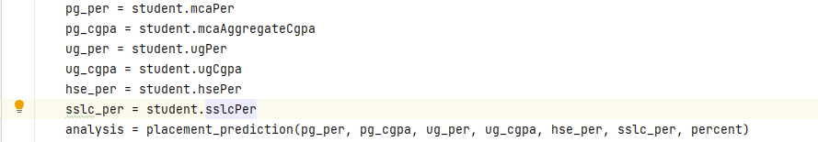
5. Method of Implementation
The dataset is read and the machine learning codes to perform the function named ‘placement_prediction’ that takes 7 arguments representing the academic scores of a student.
It is invoked when a user clicks ‘Submit Quiz’ button on the Aiken Quiz.
Amal Jyothi College of Engineering, Kanjirapally

Slide 20
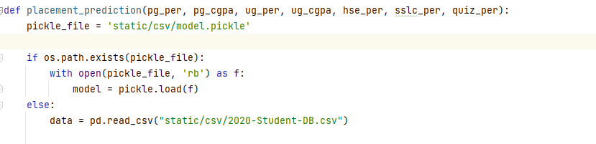
5. Method of Implementation
The model’s performance is analyzed with the existing pickle file. If not presented, then training using the data and saves it as a pickle file.
Finally, the testing is done inside the project, to check whether a prediction is correct.
Amal Jyothi College of Engineering, Kanjirapally

Slide 21
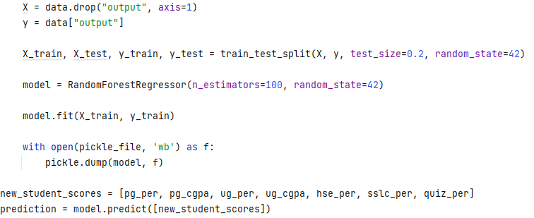
5. Method of Implementation
The trained model is then saved to a pickle file for quick loading for the next shot.
Amal Jyothi College of Engineering, Kanjirapally

Slide 22
6. Result
In this paper, we develop a prediction system that uses Random Forest to make predict the user’s placement chances.
The code is executed in Python and result of the function is returned. Then we pass the calculated result to the HTML Template using context dictionary.
The chance of getting placement percentage of the user can visible at the HTML template.
Amal Jyothi College of Engineering, Kanjirapally

Slide 23
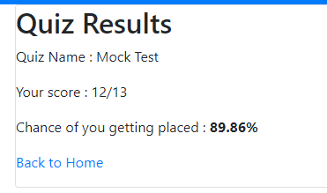

Placement Prediction in the website.
Amal Jyothi College of Engineering, Kanjirapally

Slide 24
7. Advantages & Disadvantages
Advantages
It is relatively simple to implement.
Requires little data preparation.
Can handle both categorical and continuous data.
It is also resistant to overfitting, as the randomization of the data and features reduces the variance of the model.
The algorithm is widely used in various applications such as image classification, text classification, and bioinformatics, among others.
Amal Jyothi College of Engineering, Kanjirapally

Slide 25
7. Advantages & Disadvantages
Disadvantages
Overfitting: Random Forest can over fit the data if the number of trees in the forest is too high or if the individual trees are too deep.
Computationally Expensive: Random Forest can be computationally expensive and slow to train on very large datasets or with a large number of trees in the forest.
Interpretability: While Random Forest can provide high accuracy, it can be difficult to interpret the results or understand the important features that are driving the predictions.
Amal Jyothi College of Engineering, Kanjirapally

Slide 26
7. Advantages & Disadvantages
Disadvantages
Imbalanced Data: Random Forest can be biased towards the majority class when working with imbalanced datasets, leading to lower accuracy for minority classes.
Parameters Tuning: Random Forest has several hyperparameters that need to be tuned, such as the number of trees, maximum depth of each tree, and the number of features to consider at each split. Choosing the right hyperparameters can be a challenging task.
Amal Jyothi College of Engineering, Kanjirapally

Slide 27
8. Conclusion
In the internet era, prediction systems have emerged as the single most important component of an accurate and trustworthy information source.
To give predictions to the students, this paper used the Random Forest.
The availability of the details of students makes the system’s working in utmost accuracy.
Amal Jyothi College of Engineering, Kanjirapally

Slide 28
References
[1] Rathi Viram, Swati Sinha, Bhagyashree Tayde, and Aakshada Shinde (2020). Placement prediction system using machine learning. International Journal of Creative Research Thoughts, vol. 08, issue 04, ISSN: 2320-2882.
[2] Rosemary Varghese, Adlene Peraira, Aswathy Ashok and Bassant Jhonson. (2022). Students’ performance analysis using machine learning algorithms. International Journal of Research in Engineering and Science, vol. 10, issue 61, PP 1804-1809.
[3] Shreyas Harinath, Aksha Prasad, Suma H S, Suraksha A, Tojo Mathew. (2019). Students’ placement prediction using machine learning. International Research Journal of Engineering Technology, vol 06, issue 04, ISSN: 2395-0056.
Amal Jyothi College of Engineering, Kanjirapally

Slide 29
References
[4] Irene Treesa Jose, Daibin Raju, Jeebu Abraham Aniyankunju, Joel James, and Mereen Thomas Vadakkel. (2020). Placement prediction using various machine learning models and their efficiency comparison. International Journal of Innovative Science and Research Technology, vol. 05, issue 05, ISSN: 2456-2165.
[5] Pothuganti Manvitha and Neelam Swaroopa. (2019). Campus placement prediction using supervised machine learning techniques. International Journal of Applied Engineering Research, vol. 14, issue 09, PP 2188-2191.
Amal Jyothi College of Engineering, Kanjirapally

Slide 30
Thank you
Amal Jyothi College of Engineering, Kanjirapally

